Slide 1


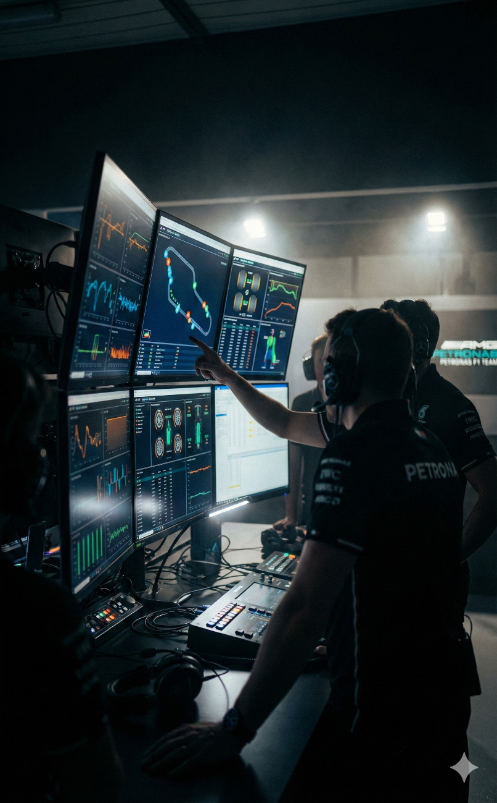





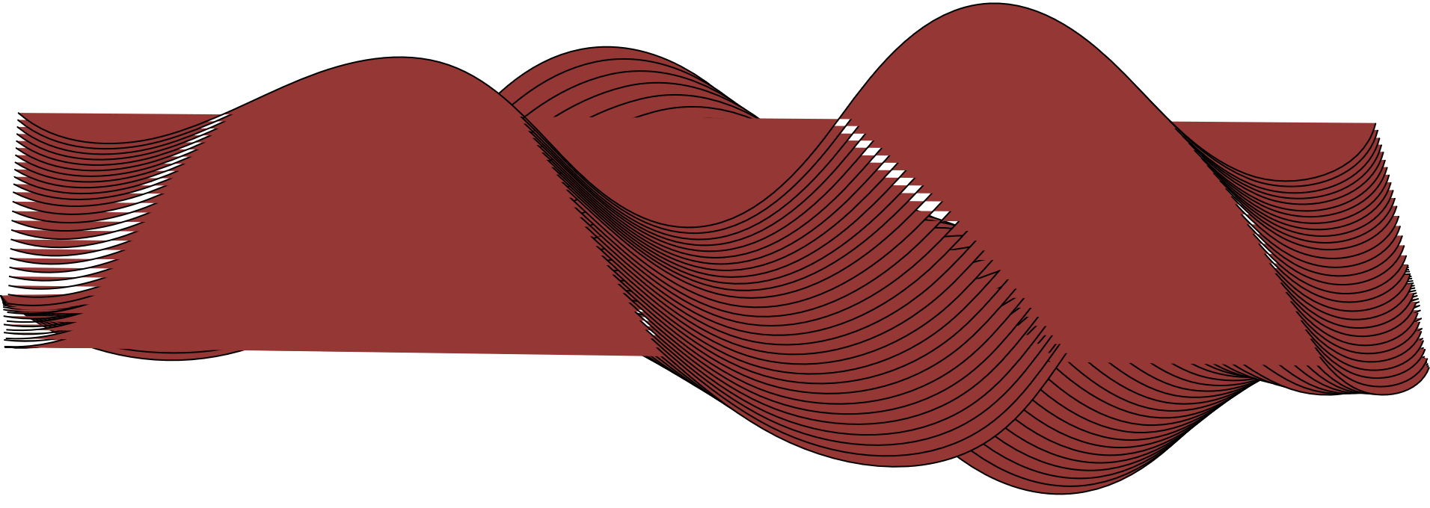

What?
Brief Description
Why?
Motivation & Purpose
A high-fidelity system that predicts F1 race outcomes using advanced analytics.
Core Function: Transforms historical data into future simulations for upcoming Grand Prix races.
The System: Hybrid architecture combining Machine Learning (Pace) with Monte Carlo Simulation (Strategy).
Bridging the Analytics Gap
The Problem: The complexity of F1 data makes it difficult to visualise how strategy calls impact the final race result.
Solution: Advanced modelling that makes technical data accessible and actionable.
Project in the Depth
Key Highlights
APEX Intelligence
Hybrid Architecture
Predictive AI
Cinematic UX
Performance Analytics
Race Simulation
A Hybrid ML & Simulation System for Predictive Motorsport Strategy.
Stall No. 99

Slide 2

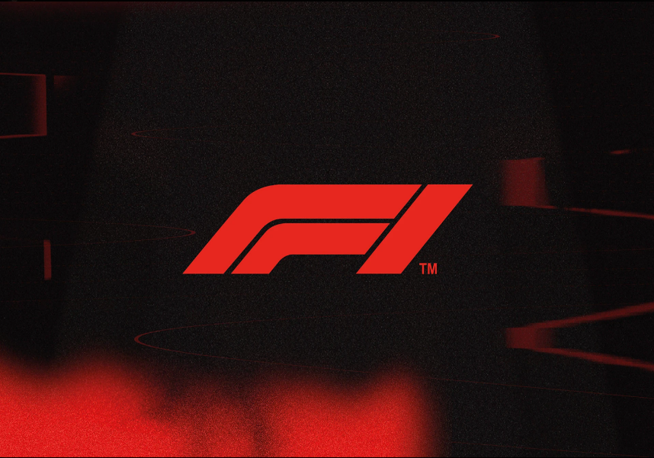


Problems Addressed
Current Alternatives in the Market
What Makes It Different:
1. F1TV (Official)
01
Forward-Looking Predictions: Predict race outcomes instead of just analysing past results.
Focus: Live Video & Replays
Gap: Expensive ($130/yr), purely observational, no predictive tools.
01
2. TracingInsights
Precision Performance Analytics: Real-time analysis of tyre degradation and pace deltas.
Passive Viewership affected/benefited
Focus: Deep Historical Analytics
Gap: Dense "spreadsheet" UI, lacks forward-looking simulation.
02
02
Complex, Fragmented Data
3. OpenF1
Focus: Raw Data API
Gap: Developer-only tool, no visual interface or strategic layer.
03
Hybrid Intelligence Engine: Fuses Machine Learning with physics-based race rules.
03
Reactive Race Strategy
04
Cinematic Data UX: Broadcast-quality visualisation, not dry spreadsheets.
How we are different from competition?
Impact & Future Scope
Cost: Freemium vs. $130/yr Subscription
Live 3D Race Replay
Technology: Hybrid ML & Physics Engine
Active Fan Engagement
Features: Predictive Simulation & Strategy
Trackside Mobile Ecosystem
Experience: Cinematic 3D vs. Static Charts
Monte Carlo Strategy Engine

